Slide 1
Platforms Movies & TV Shows
Presented By:
Mohammed Adel Eltohamy
Mohamed Arafa
Hossam Mohamed
Agenda:
Introduction to datasets
Data Cleaning & Processing
Data Modeling
Dashboards

Slide 2
Introduction To Platforms Datasets
3 datasets about Netflix, Amazon Prime and Disney Plus movies and TV Shows.
Data include Information about:
Shows (Type, Title, Duration, Genres, country, etc..)
Cast & Directors
Dates when shows were added to platforms.
Additional Dataset about Netflix Subscription Fees.

Slide 3
Data Cleaning & Processing
Cleaning operations:
Import data and delete empty rows.
Split Director, Country, Cast and Genre (Listed in) Columns.
Unpivoting for Director, Country, Cast and Genre (Listed in) Columns.
Remove duplicate from rows.
Remove the Show ID column when merge the three datasets.
Add New indexing column to the merged datasets.
Replacing Null values in columns.

Slide 4
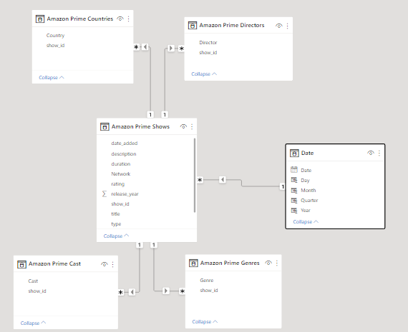
Data Modeling
Example: Amazon prime data.
Fact Table: Amazon Prime Shows
Dimension tables:
Amazon Prime Cast Dimension
Amazon Prime Genre Dimension
Amazon Prime Shows Dimension
Amazon Prime Countries Dimension
Date Dimension

Slide 5
Measures & Tables created
Tables Created:
Date table: Contain (date, Month, day, year, Quarter)
Measures created:
Measures to calculate distinct No. of directors (Directory No.)
Measure to Calculate total No. of Shows (All Shows)
Measure to Calculate the average of different type of fees (Cost)
Measure to Calculate the average No. of TV shows, movies & libraries in each country (Shows)

Slide 6
Dashboards
Information had been Showed in dashboards:
Slicers: (Shows type, Years, Country)
Durations (TV shows per season, Movies per Min)
Rating categories
Show added per years
Genres
Number of shows & directors
Shows nationalities (Country)
Average basic fee, Average standard fee & Average premium fee

Slide 7
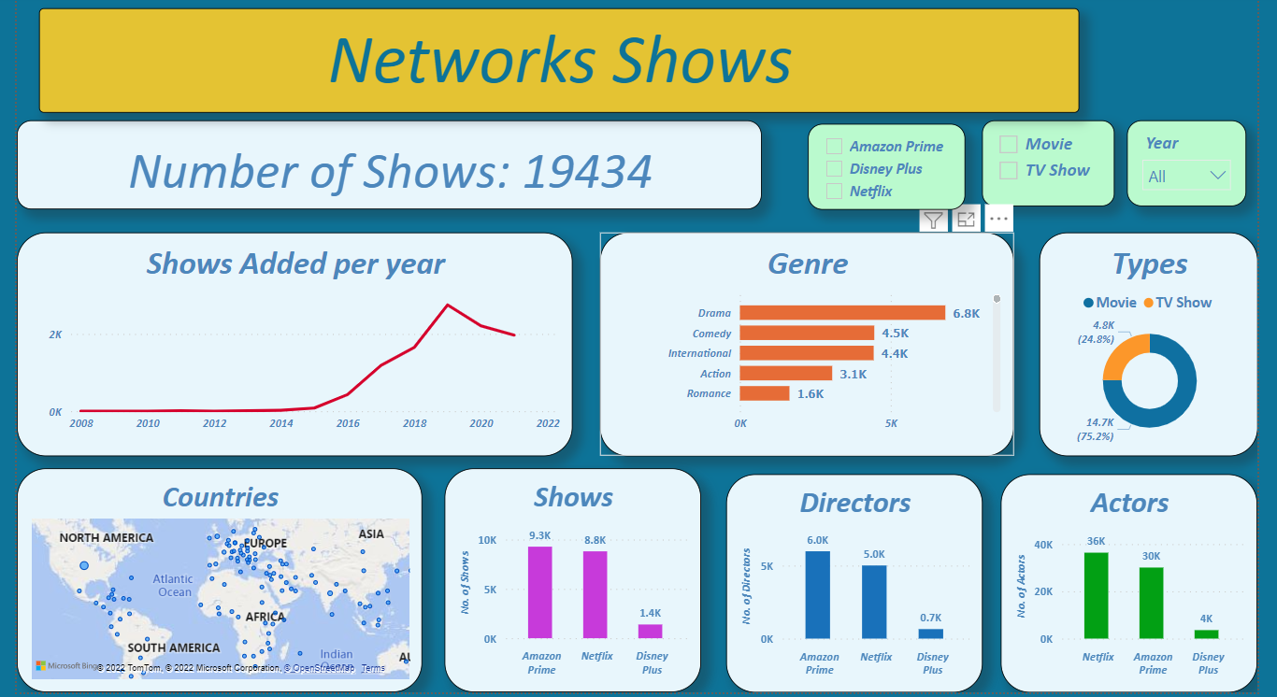
Merged Three Datasets

Slide 8
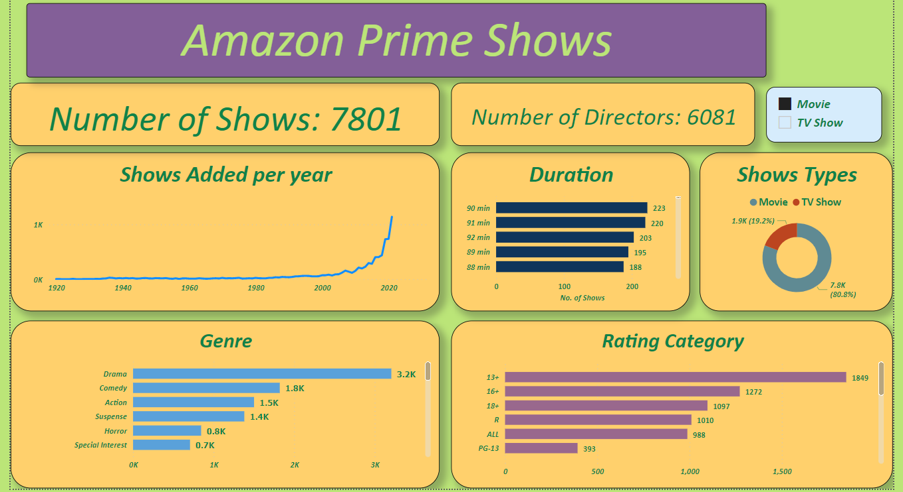
Amazon Prime Shows

Slide 9
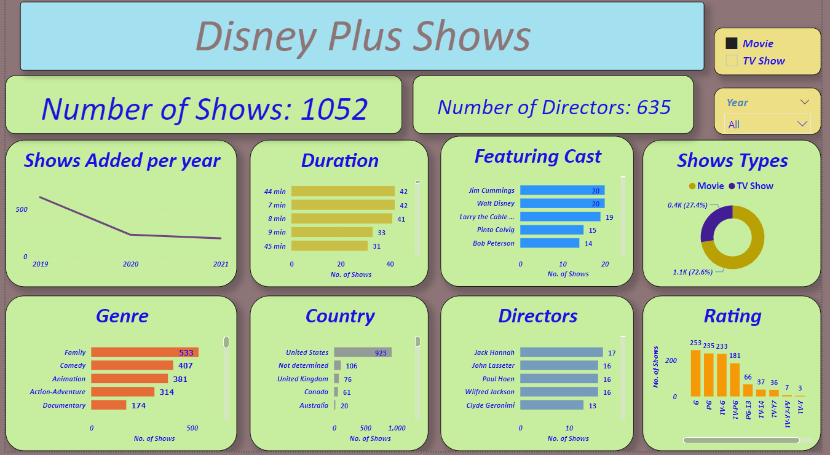
Disney Plus Shows

Slide 10
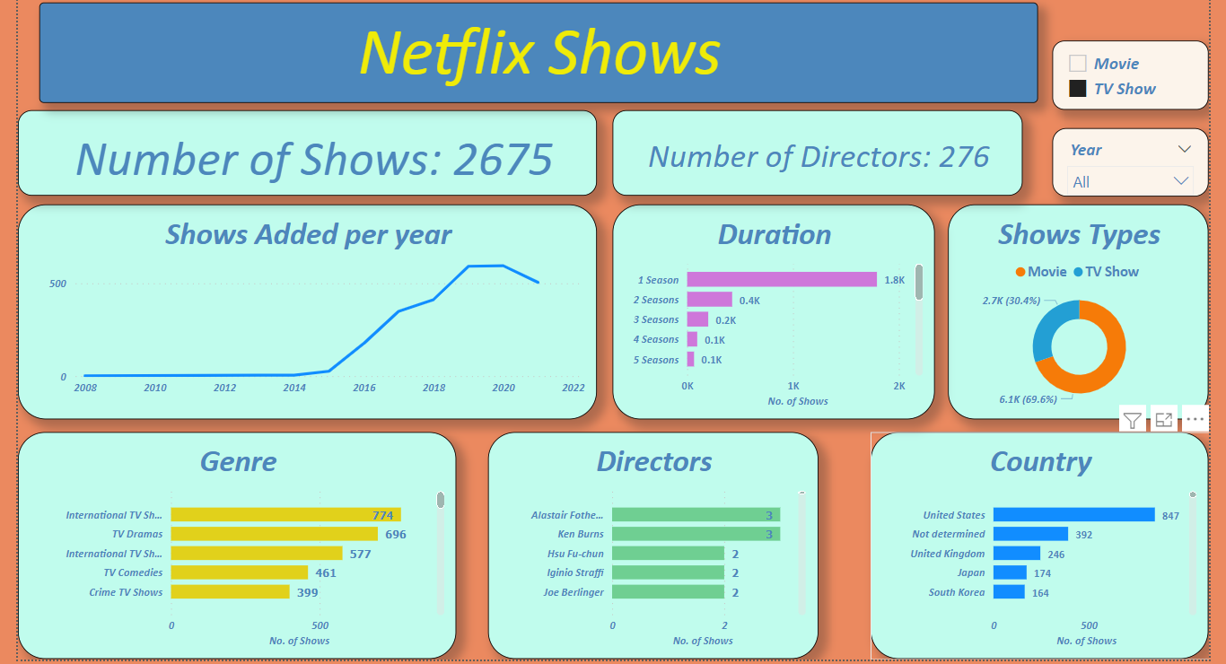
Netflix Shows

Slide 11
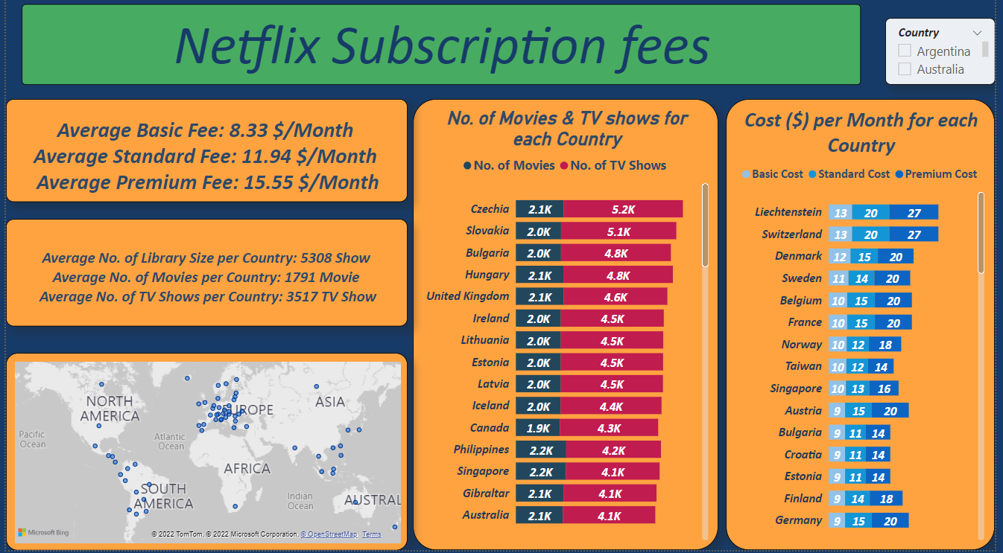
Netflix Subscription Fees

